Slide 1
UNIT-I
FUNCTIONS

Slide 2
Definition:
A function is a block of code which only runs when it is called. (Or) A function is a self contained block of statements to solve a particular problem.
A program can be divided into several subprograms. Each sub program is a function.
The process of dividing a program several subprograms is nothing but MODULAR PROGRAMMING.
You can pass data, known as parameters, into a function.
A function can return data as a result.

Slide 3
Advantages of Functions:
Reusability of Code
Remove Redundancy
Decrease Complexity
Debugging Easy
Types of function:
There are two types of functions:
Standard Library Functions - Built-in Functions
Example: abs(), float(), all(), eval() etc
2. User-defined Functions - functions created by the user
Example: display()

Slide 4
Here are simple rules to define a function in Python.
1) Function blocks begin with the keyword def followed by the function name and parentheses ( ).
2) All input parameters/arguments should be placed within parentheses.
3) The first statement of a function can be an optional statement - the documentation string of the function or docstring.
4) The code block within every function starts with a colon (:) and is indented.
5) The statement return [expression] exits a function optionally passing back an expression to the caller (back to Calling function).

Slide 5
Syntax:
def function_name( parameters):
"function_docstring"
Bunch of statements
return [expression]
Ex-1:
def add(x):
x = x+2
a=10
b=20
C=30
print("Before....", a, b, c)
add(a)
add(b)
add(c)
print("After...", a, b, c)
Note: A function can return more than one value in Python.
Ex: return a, b, c. Here the values are returned as a TUPLE.

Slide 6
Flow of Control
....................
...................
Func1 ()
..................
...................
def Func1 ():
#function code
..................
...................
..................
Calling a function & Called Function
def fun1 ():
.........
.........
Fun2()
..........
def fun2 ():
.........
.........
Fun3()
..........
def fun3 ():
.........
.........
Fun4()
..........
def fun4 ():
.........
.........
.........
.........

Slide 7
Ex-2: Returning a Single value
def factorial(n):
f = 1
for i in range(1,n+1):
f = f*i
return f
num = int(input("Enter any number"))
print("factorial = ", factorial(num))
Ex-3: Returning Multiple Values
def arithmetic_op(a, b):
c=a+b
d = a-b
e = a*b
f = a/b
return c,d,e,f
result = arithmetic_op(6,8)
for i in result:
print(i, end=’,’)

Slide 8
Modules:
A module is a file containing Python definitions and statements. The file name is the module name with the suffix.py appended.
import modulename
Modulename.functionname()
Packages in Python
A package is a hierarchical file directory structure that defines a single Python application environment that consists of modules and subpackages and subsubpackages, and so on.
pip install <package_name>
NumPy: It provides some advanced math functionalities to python.
SciPy: It is a library of algorithms and mathematical tools for python and has caused many scientists to switch from ruby to python.
Matplotlib: It is a numerical plotting library. It is very useful for any data scientist or any data analyzer.

Slide 9
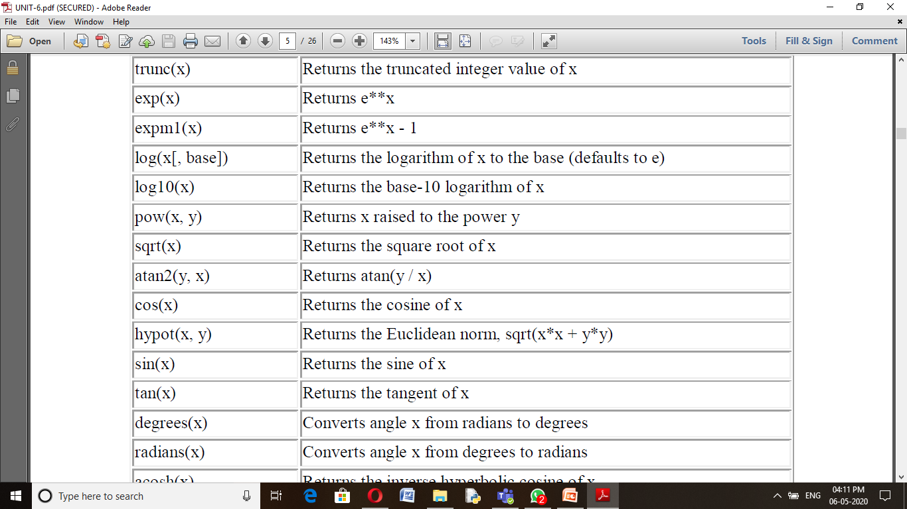

Slide 10
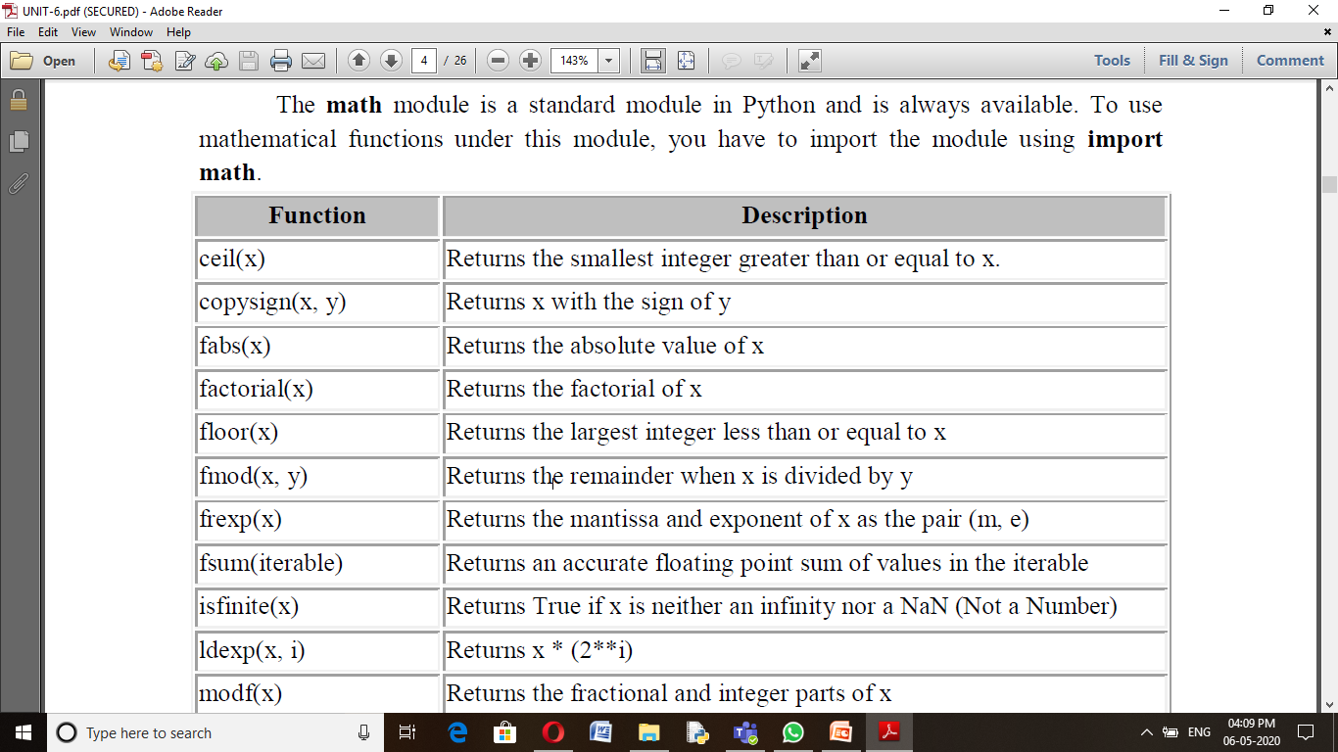

Slide 11
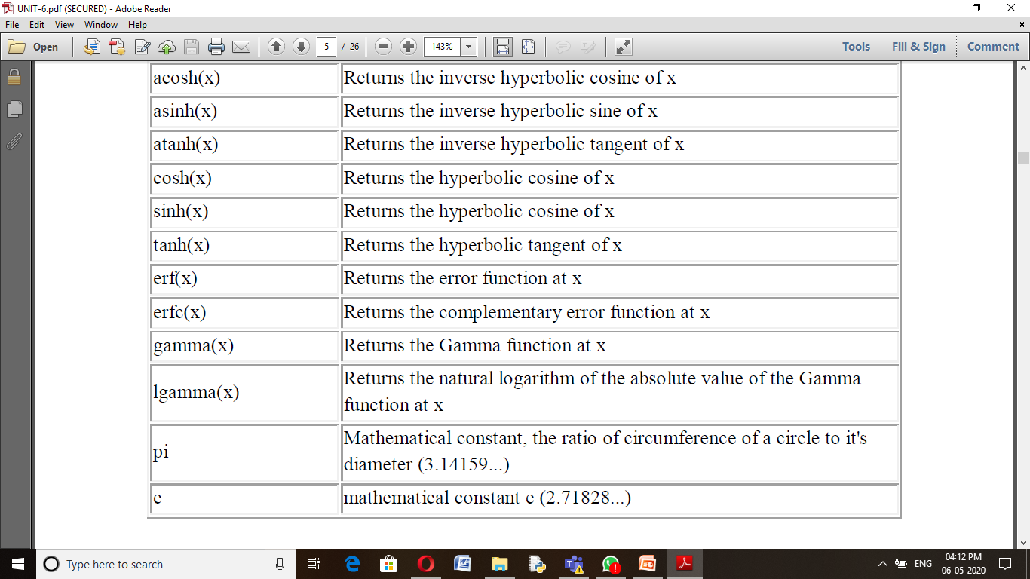

Slide 12
>>> import math
>>>math.pi
3.141592653589793
>>>math.log10(10)
1.0
>>>math.exp(10)
1.0
>>>math.e
2.718281828459045
>>>math.e**10
22026.465794806703
>>>math.radians(30)
0.5235987755982988
>>>math.degrees(math.pi/6)
29.999999999999996
>>>math.pow(2,4)
16.0
>>>2**4
16
>>math.sin(0.5235987755982988)
0.49999999999999994
>>>math.cos(0.5235987755982988)
0.8660254037844387
>>>math.tan(0.5235987755982988)
0.5773502691896257
>>>math.sqrt(100)
10.0
>>>math.sqrt(3)
1.7320508075688772
>>>math.ceil(4.5867)
5
>>>math.floor(4.5687)
4
>>>math.log(10)
2.302585092994046

